Slide 1


Computational Intelligence (TC2027)

Slide 2
Unit 5 – System Security (I)
User Authentication
Unix Access Control

Slide 3

User Authentication

Slide 4
The AAA
Authentication: Figures out WHO is accessing
Access control: Ensure ONLY AUTHORIZED ACCESS are allowed
Auditing: RECORD WHAT IS HAPPENING, to identify attacks later and recover
Notes:
Shutting down to allow no access may be secure, but is not useful

Slide 5
Authentication & Access Control
Authentication is the act of establishing or confirming something (or someone) as authentic, that is, that claims made by or about the subject are true. This might involve confirming the identity of a person, tracing the origins of an artifact, ensuring that a product is what its packaging and labeling claims to be, or assuring that a computer program is a trusted one.
Access control is a system which enables an authority to control access to areas and resources in a given physical facility or computer-based information system.
Notes:
When you start your computer and log into your bank, several layers of authentication typically have occurred. How many are there?

Slide 6
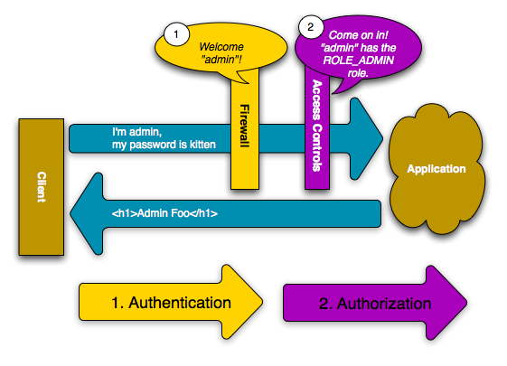
Authentication & Access Control
Notes:
When you start your computer and log into your bank, several layers of authentication typically have occurred. How many are there?

Slide 7

User Authentication
Using a method to validate users who attempt to access a computer system or resources, to ensure they are authorized.

Slide 8
Types of User Authentication
Something you know
E.g., user account names and passwords
Something you have
Smart cards or other security tokens
Something you are
Biometrics

Slide 9
Scenarios Requiring Authentication
Scenarios
Logging into a local computer
Logging into a computer remotely
Access web sites
Potential vulnerabilities to consider when client authenticating server
channel between the client and the server
server compromise
client compromise
social engineering
weak passwords
What are some threats?

Slide 10
Variants of Passwords
Password
Passphrase
a sequence of words or other text used for similar purpose as password
Passcode
Personal identification number (PIN)

Slide 11
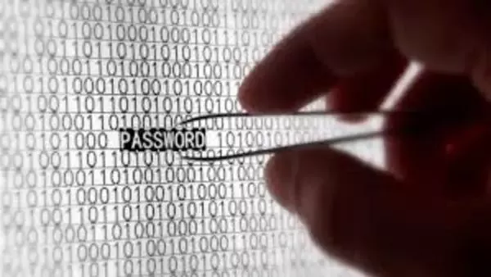
Threats to Passwords
Eavesdropping (insecure channel between client and server)
Login spoofing (human errors), shoulder surfing, keyloggers
Offline dictionary attacks
Social engineering (human errors)
e.g., pretexting: creating and using an invented scenario (the pretext) to persuade a target to release information or perform an action and is usually done over the telephone
Online guessing (weak passwords)

Slide 12
Guessing Attacks: Two Factors for Password Strength
The average number of guesses the attacker must make to find the correct password
determined by how unpredictable the password is, including how long the password is, what set of symbols it is drawn from, and how it is created.
The ease with which an attacker can check the validity of a guessed password
determined by how the password is stored, how the checking is done, and any limitation on trying passwords

Slide 13
Example of Weak Passwords (from Wikipedia)
Default passwords (as supplied by the system vendor and meant to be changed at installation time): password, default, admin, guest, etc.
Dictionary words: chameleon, RedSox, sandbags, bunnyhop!, IntenseCrabtree, etc.
Words with numbers appended: password1, deer2000, john1234, etc.
Words with simple obfuscation: p@ssw0rd, l33th4x0r, g0ldf1sh, etc.
Doubled words: crabcrab, stopstop, treetree, passpass, etc., can be easily tested automatically.

Slide 14
Example of Weak Passwords (from Wikipedia)
Common sequences from a keyboard row: qwerty, 12345, asdfgh, fred, etc.
Numeric sequences based on well known numbers such as 911, 314159, or 27182, etc.,
Identifiers: jsmith123, 1/1/1970, 555–1234, "your username", etc.,
Anything personally related to an individual: license plate number, Social Security number, current or past telephone number, student ID, address, birthday, sports team, relative's or pet's names/nicknames/birthdays, etc.
Notes:
Top 20 Passwords In 32 million RockYou.com passwords
http://www.tomshardware.com/news/imperva-rockyou-most-common-passwords,9486.html
The Top 500 Worst Passwords of All Time
http://www.whatsmypass.com/the-top-500-worst-passwords-of-all-time

Slide 15
Password psychological acceptability
It is essential that the human interface be designed for ease of use, so that users routinely and automatically apply the protection mechanisms correctly.
Also, to the extent that the user's mental image of his protection goals matches the mechanisms he must use, mistakes will be minimized.
If he must translate his image of his protection needs into a radically different specification language, he will make errors.

Slide 16
Storing Passwords (UNIX Case Study)
Old UNIX
The file /etc/passwd stores H(password) together with each user’s login name, user id, home directory, login shell, etc.
H is essentially a one-way hash function!
The file /etc/passwd must be world readable.
Brute force attacks possible even if H is one-way.
Modern UNIX
Divide /etc/password into two files: /etc/password; and /etc/shadow (readable only by root)
Store [r, H(password,r)] rather than H(password) in /etc/shadow
r is randomly chosen for each password
r is public, similar to Initial Vector in CBC & CTR modes
Benefits
dictionary attacks much more difficult
cost of attacking a single account remains the same
if two users happen to choose the same password, it doesn’t immediately show.

Slide 17
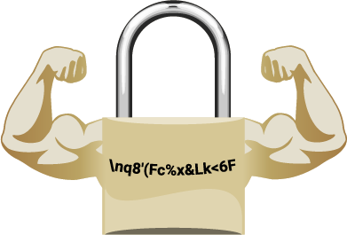
Mechanisms to Defend Against Dictionary and Guessing Attacks
Protect stored passwords (use both cryptography & access control)
Disable accounts with multiple failed attempts
Require extra authentication mechanism (e.g., phone, other email account, etc.).

Slide 18

Spoofing & Defenses on the Web
Phishing attacks: attempting to acquire sensitive information such as usernames, passwords and credit card details by masquerading as a trustworthy entity in electronic communication.
Website forgery: Set up fake websites that look like e-commerce sites and trick users into visiting the sites and entering sensitive info.

Slide 19
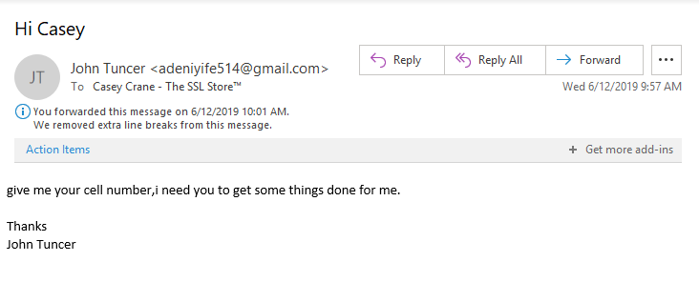
Types of Phishing Attack
CEO Fraud/Business Email Compromise
Whaling, a form of spear phishing, is a lot like the inverse version of CEO fraud. Instead of targeting lower-level individuals within an organization, the cybercriminal instead targets high-level executives such as CEOs, CFOs, and COOs.

Slide 20
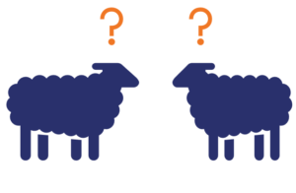
Types of Phishing Attack
Clone phishing: take advantage of legitimate messages that the victim may have already received and create a malicious version of it.
The attack creates a virtual replica of a legitimate message — hence, the attack’s clever name — and sends the message from an email address that looks legitimate.
Any links or attachments in the original email are swapped out for malicious ones.

Slide 21

Types of Phishing Attack
Domain spoofing: This method of attack uses either email or fraudulent websites.
Domain spoofing occurs when a cybercriminal “spoofs” an organization or company’s domain to:
make their emails look like they’re coming from the official domain, or
make a fake website look like the real deal by adopting the real site’s design and using either a similar URL or Unicode characters that look like ASCII characters.

Slide 22

Types of Phishing Attack
Evil Twin: an evil twin attack is a form of phishing that capitalizes on Wi-Fi.
Evil twin phishing involves a cybercriminal creating a Wi-Fi hotspot that looks like the real one — they’ll even use the set service identifier (SSID) that is the same as the real network.
When end-users connect, the attacker can then eavesdrop on their network traffic and steal their account names, passwords, and view any attachments that the user accesses while connected to the compromised hotspot.

Slide 23
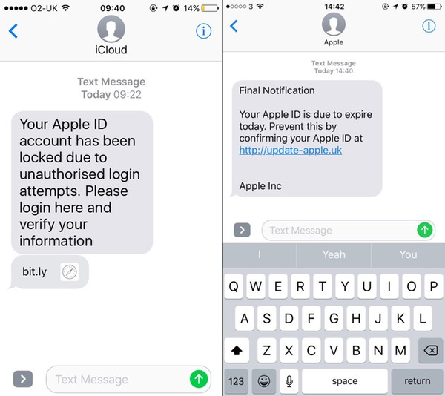
Types of Phishing Attack
Smishing: SMS phishing, or “smishing,” is a form of phishing that capitalizes on the world’s addiction to text messaging and instant communications.
Smishing is a way for cybercriminals to lure users into downloading malicious payloads by sending text messages that appear to come from legitimate sources and contain malicious URLs for them to click on.

Slide 24
Phishing Defenses on the Web
Browser filtering of known phishing sites
Cryptographic authentication of servers (will talk about in future)
User-configured authentication of servers
To ensure that the site is the one the human user has in mind
E.g., site key, pre-selected picture/phrases

Slide 25
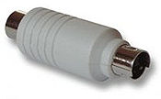
KeyLogging
Threats from insecure client side.
Keystroke logging (keylogging) is the action of tracking (or logging) the keys struck on a keyboard, typically in a covert manner so that the person using the keyboard is unaware that their actions are being monitored.
Software–based: key-stroke events, grab web forms, analyze HTTP packets
Hardware-based: Connector, wireless sniffers, acoustic based
Defenses: Anti-spyware, network monitors, on-screen soft keyboard, automatic form filler, etc.

Slide 26
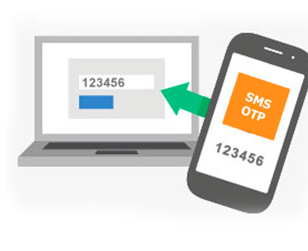
Using Passwords Over Insecure Channels
One-time passwords:
Each password is used only once
Defend against passive adversaries who eavesdrop and later attempt to impersonate
Challenge response: Send a response related to both the password and a challenge.
Zero knowledge proof of knowledge: Prove knowledge of a secret value, without leaking any info about the secret.

Slide 27
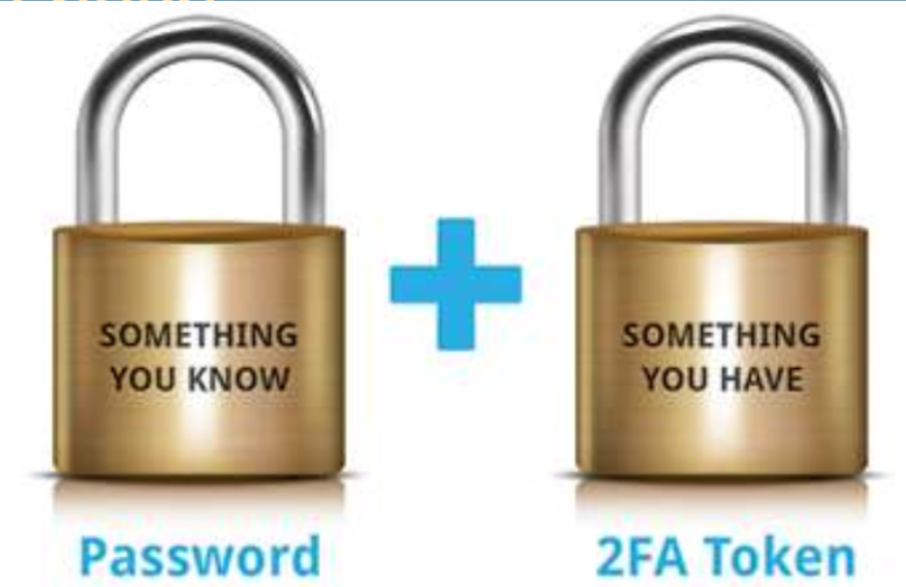
Double Factor Authentication (2FA)
2FA provides a significant increase in the security.
The two factor of 2FA are something you know + something you have.
The additional factor “something you have” is the key factor . It can be either token’s , smart-cards or biometric .

Slide 28
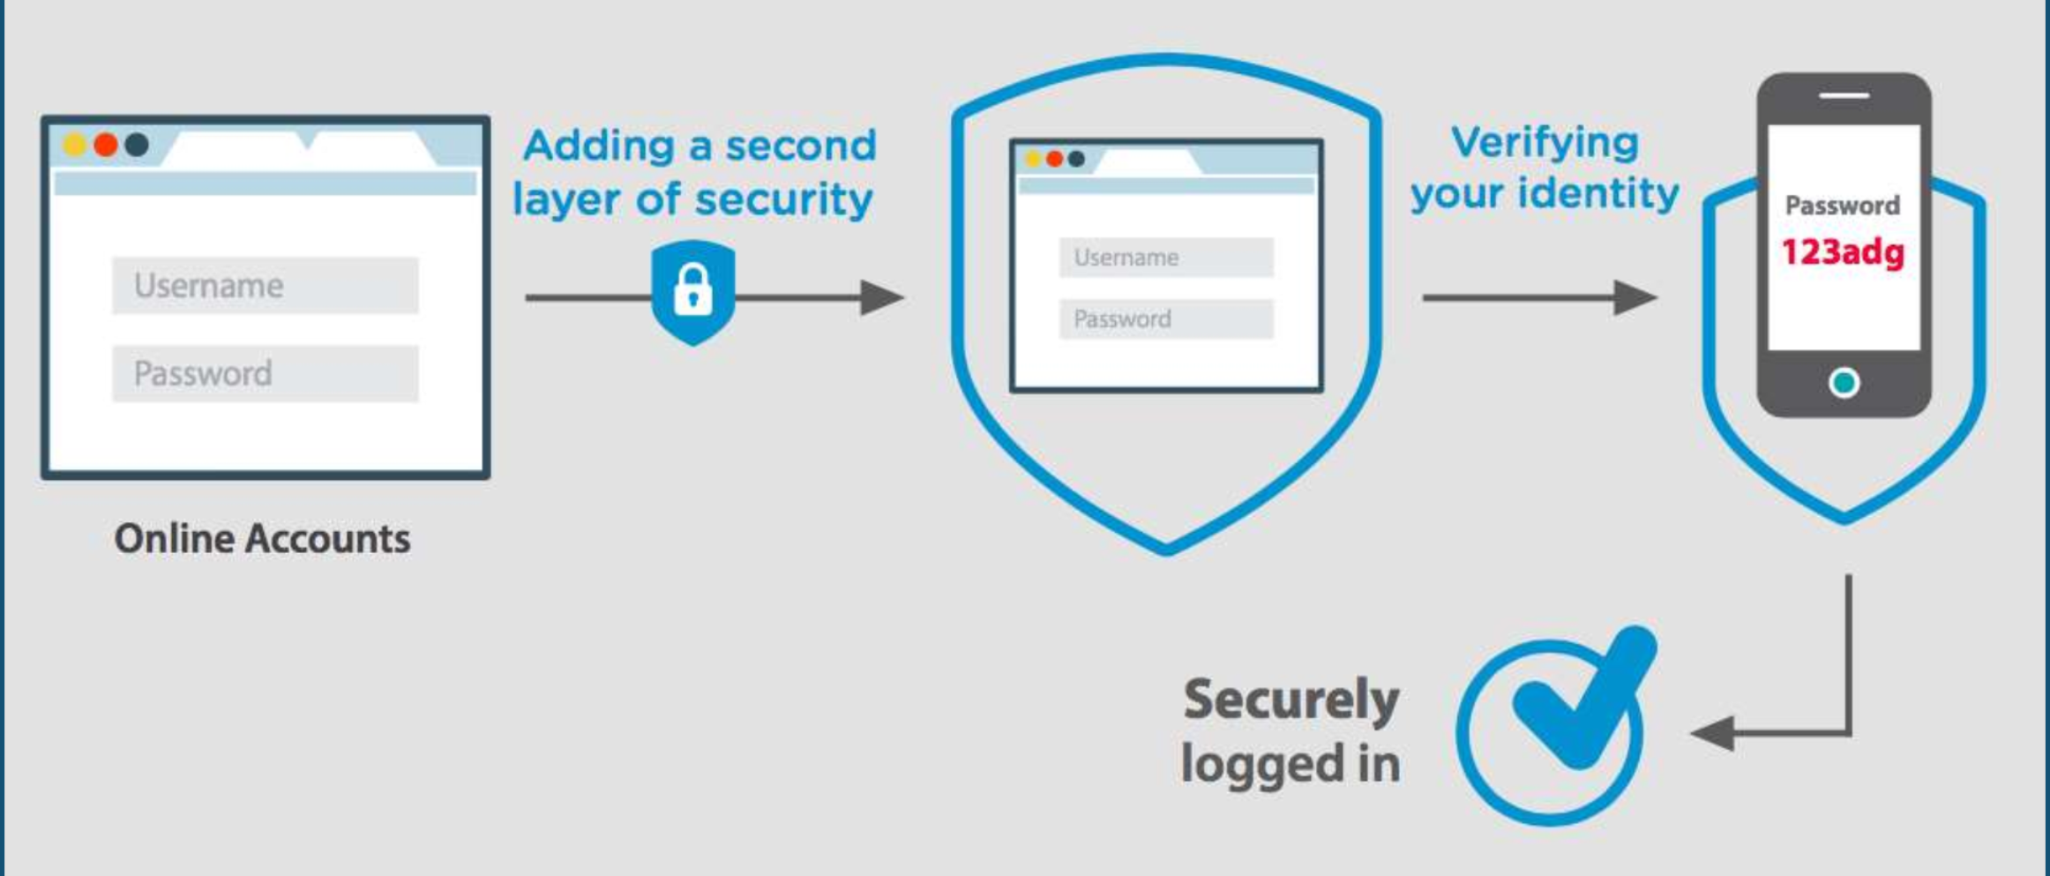
Double Factor Authentication (2FA)

Slide 29
2FA Tokens
One Time Password (OTP) is a second layer of security to verify your identity.
Software OTP: An OTP generated by the company and sent to your mobile phone or PC.
Hardware OTP: An OTP generated by a security device/token. You press the button on device/token to obtain the OTP.
Event Based OTP: Here the moving factor is triggered by event .
Time Based OTP: Here the moving factor is time.

Slide 30
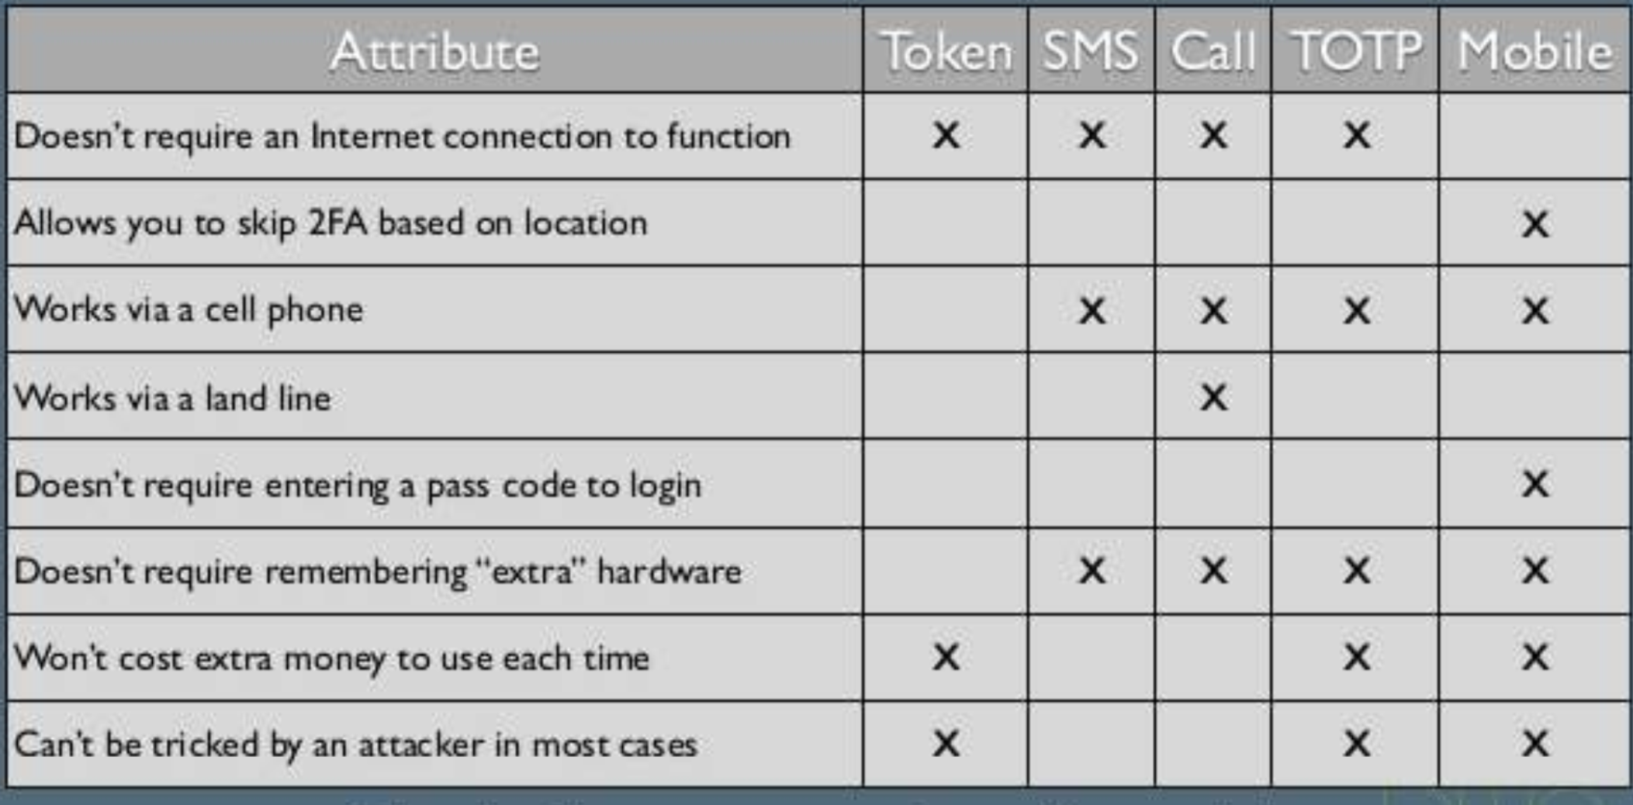
2FA Tokens Comparision

Slide 31
Unix Access Control

Slide 32
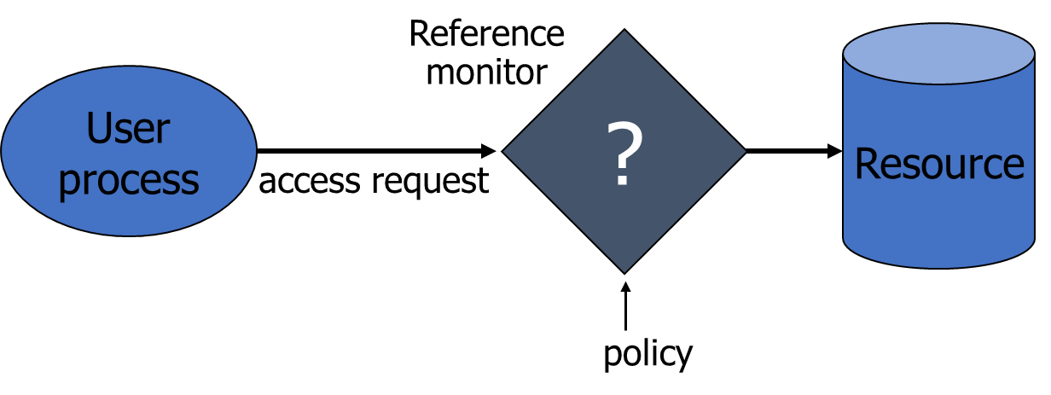
Access control
A reference monitor mediates all access to resources
Tamper-proof;
Complete mediation: control all accesses to resources;
Small enough to be analyzable.
Notes:
Tamper-proof: prova de adulteração

Slide 33
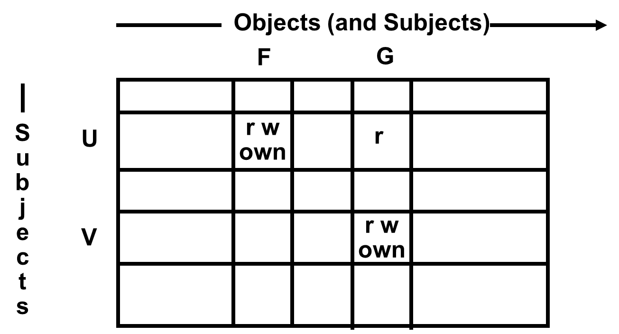
Access Matrix model
Basic Abstractions
Subjects
Objects
Rights
The rights in a cell specify the access of the subject (row) to the object (column)

Slide 34
Access Matrix model
Subject: is a program (application) executing on behalf of some principal(s).
Principal: may at any time be idle or have one or more subjects executing on its behalf.

Slide 35
Access Matrix model
Object: is anything on which a subject can perform operations (mediated by rights).
Usually objects are passive, for example: File, Directory (or Folder), Memory segment.
But, subjects can also be objects, with operations: kill, suspend, resume.

Slide 36
UNIX Access Control: Users, Groups, Files, Processes
Each user account has a unique UID: The UID 0 means the super user (system admin)
A user account belongs to multiple groups.
Subjects are processes: associated with uid/gid pairs, e.g., (euid, egid), (ruid, rgid), (suid, sgid)
Objects are files.

Slide 37
UNIX Access Control: Users, Groups, Files, Processes
USERS
PRINCIPALS
Unit of Access Control
and Authorization
Real World User
the system authenticates the human user to a particular principal

Slide 38
File Objects Organization
Almost all objects are modeled as files
Files are arranged in a hierarchy
Files exist in directories
Directories are also one kind of files
Each object has
owner
group
12 permission bits
rwx for owner, rwx for group, and rwx for others
suid, sgid, sticky

Slide 39
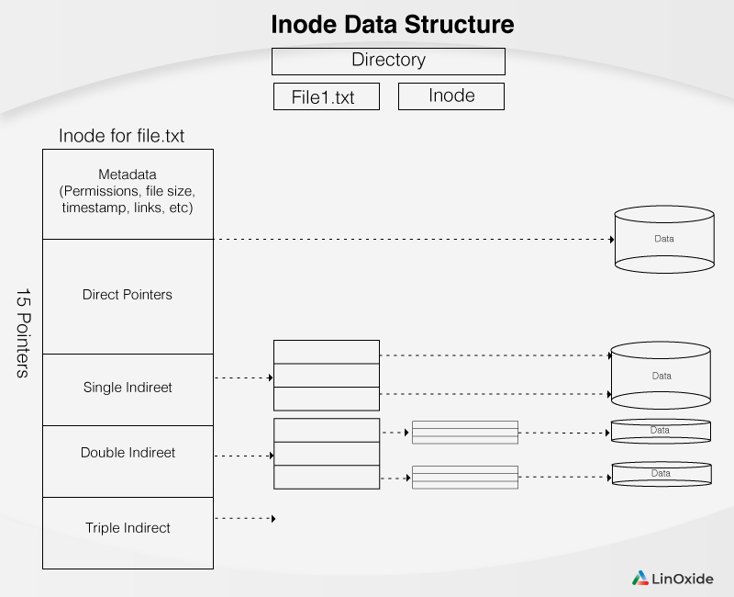
Unix Inode
The inode (index node) is a data structure in a Unix-style file system that describes a file-system object such as a file or a directory.
Each inode stores the attributes and disk block locations of the object's data.

Slide 40
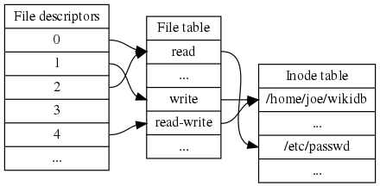
Unix Inode
File descriptor is a unique identifier for a file or other input/output resource, such as a pipe or network socket.
Inode Table: Table that stores all inodes informations.

Slide 41
Symbolic Links (or soft links)
The symbolic link is a separate file whose contents point to the linked-to file.
The original file is just a name that is connected directly to the inode, and the symbolic link refers to the name.

Slide 42
Symbolic Links (or soft links)
# ln -s /home/bobbin/sync.sh filesync
# ls -l filesync
lrwxrwxrwx 1 root root 20 Apr 7 06:08 filesync -> /home/bobbin/sync.sh
# ls -il /home/bobbin/sync.sh filesync
258674 lrwxrwxrwx 1 root root 20 Apr 7 06:08 filesync -> /home/bobbin/sync.sh
517333 -rw-r----- 1 root root 5 Apr 7 06:09 /home/bobbin/sync.sh

Slide 43
Hard Links
To get an idea of what a hard link is, it is important to understand that the identity of a file is its inode number, not its name.
A hard link is a name that references an inode. It means that if 'file1' has a hard link named 'file2', then both of these files refer to same inode.

Slide 44
Hard Links
# ls -l /home/bobbin/sync.sh
-rw-r----- 1 root root 5 Apr 7 06:09 /home/bobbin/sync.sh
# ln /home/bobbin/sync.sh synchro
# ls -il /home/bobbin/sync.sh synchro
517333 -rw-r----- 2 root root 5 Apr 7 06:09 /home/bobbin/sync.sh
517333 -rw-r----- 2 root root 5 Apr 7 06:09 synchro

Slide 45
Basic Permissions Bits on Files (Non-directories)
Read controls reading the content of a file
i.e., the read system call
Write controls changing the content of a file
i.e., the write system call
Execute controls loading the file in memory and execute
i.e., the execute system call

Slide 46
Unix File Attributes
Owner permissions: The owner's permissions determine what actions the owner of the file can perform on the file.
Group permissions: The group's permissions determine what actions a user, who is a member of the group that a file belongs to, can perform on the file.
Other (world) permissions: The permissions for others indicate what action all other users can perform on the file.

Slide 47
File Access Modes
Read: Grants the capability to read, i.e., view the contents of the file.
Write: Grants the capability to modify or remove the content of the file.
Execute: User with execute permissions can run a file as a program.

Slide 48
Directory Access Modes
Read: Access to a directory means that the user can read the contents. The user can look at the filenames inside the directory.
Write: Access means that the user can add or delete files from the directory.
Execute:
Executing a directory doesn't really make sense, so think of this as a traverse permission.
A user must have executed access to the bin directory in order to execute the ls or the cd command.

Slide 49
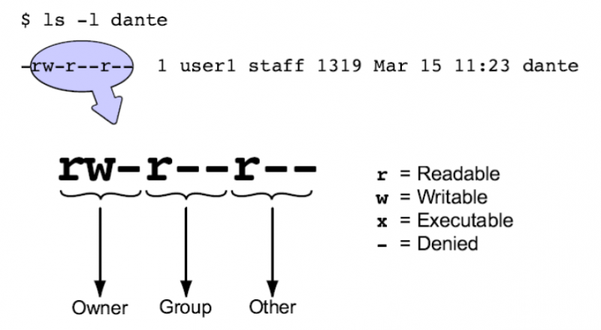
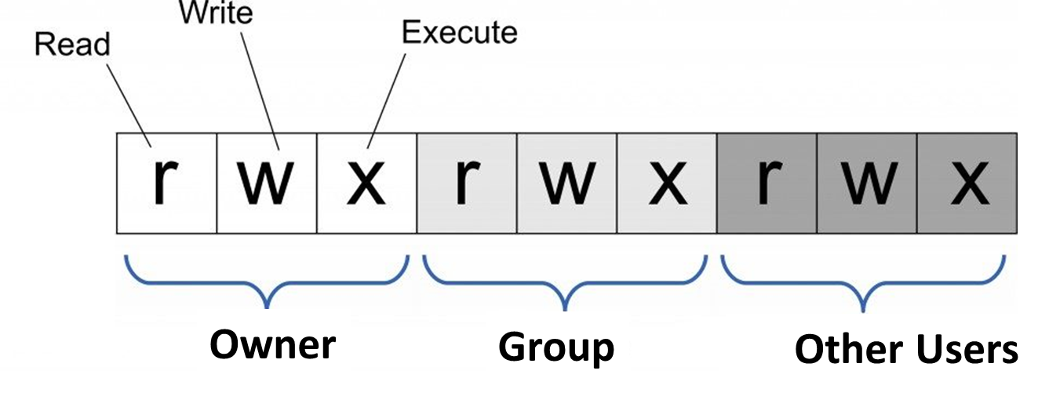
Setting Permissions

Slide 50
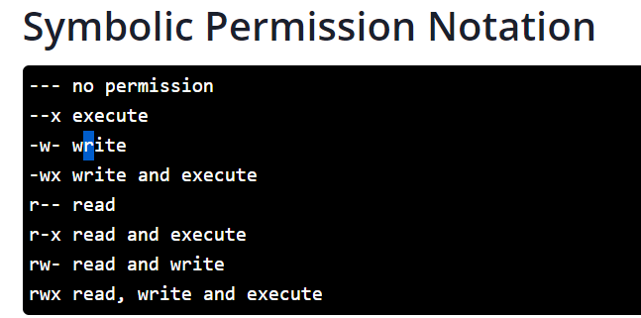
Setting Permissions

Slide 51
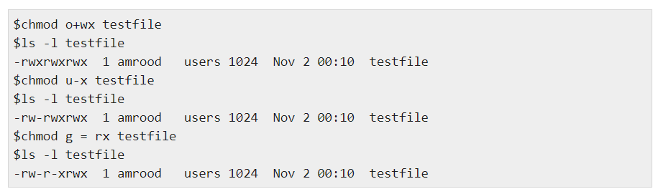
Setting Permissions

Slide 52
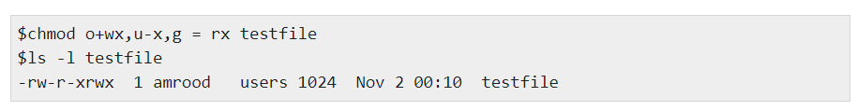
Setting Permissions

Slide 53
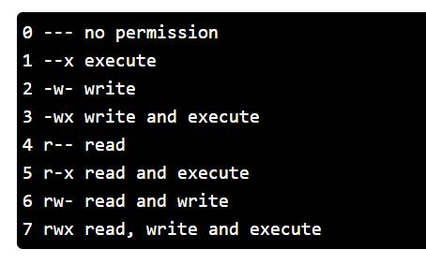
Setting Permissions

Slide 54
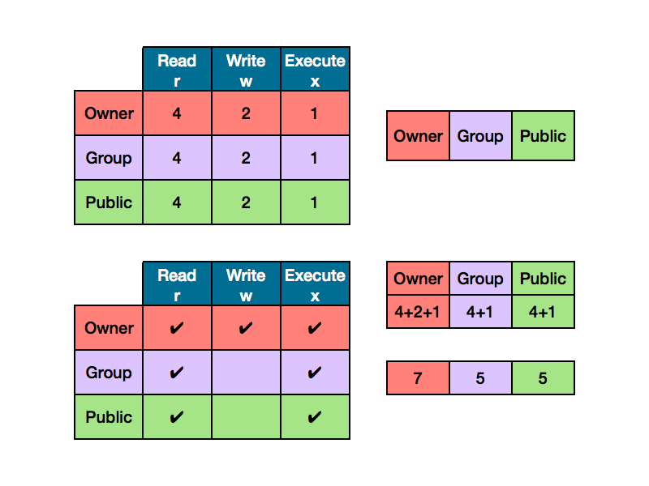
Setting Permissions

Slide 55
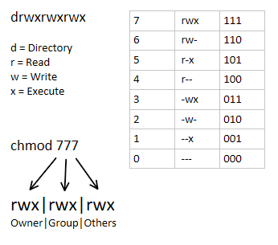
Setting Permissions

Slide 56
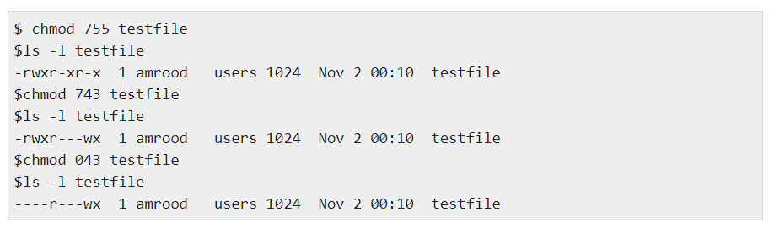
Setting Permissions

Slide 57
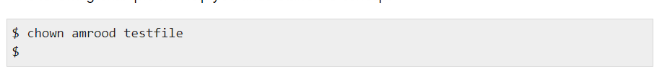
Changing Owners and Groups

Slide 58
SUID and SGID File Permission
Often when a command is executed, it will have to be executed with special privileges in order to accomplish its task.
As an example, when you change your password with the passwd command, your new password is stored in the file /etc/shadow.
As a regular user, you do not have read or write access to this file for security reasons, but when you change your password, you need to have the write permission to this file.
This means that the passwd program has to give you additional permissions so that you can write to the file /etc/shadow.

Slide 59
SUID and SGID File Permission
Additional permissions are given to programs via a mechanism known as the Set User ID (SUID) and Set Group ID (SGID) bits.
When you execute a program that has the SUID bit enabled, you inherit the permissions of that program's owner. Programs that do not have the SUID bit set are run with the permissions of the user who started the program.
The SUID and SGID bits will appear as the letter "s" if the permission is available.

Slide 60
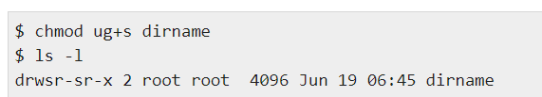
SUID and SGID File Permission
If the sticky bit is enabled on the directory, files can only be removed if you are one of the following users:
The owner of the sticky directory
The owner of the file being removed
The super user, root

Slide 61
Subjects vs. Principals
Access rights are specified for users (accounts)
Accesses are performed by processes (subjects)
The OS needs to know on which users’ behalf a process is executing

Slide 62
Process User ID Model in Modern UNIX Systems
Each process has three user IDs
real user ID (ruid): owner of the process
effective user ID (euid): used in most access control decisions
saved user ID (suid)
and three group IDs
real group ID
effective group ID
saved group ID

Slide 63
Process User ID Model
When a process is created by fork
it inherits all three users IDs from its parent process
When a process executes a file by exec
it keeps its three user IDs unless the set-user-ID bit of the file is set, in which case the effective uid and saved uid are assigned the user ID of the owner of the file
A process may change the user-id via system calls

Slide 64
The Need for suid/sgid Bits
Some operations are not modeled as files and require user id = 0 (root)
halting the system
bind/listen on “privileged ports” (TCP/UDP ports below 1024)
non-root users need these privileges
File level access control is not fine-grained enough
System integrity requires more than controlling who can write, but also how it is written

Slide 65
Setuid()
Setuid is a Linux file permission setting that allows a user to execute that file or program with the permission of the owner of that file.
This is primarily used to elevate the privileges of the current user.
If a file is “setuid” and is owned by the user “root” then a user that has the ability to execute that program will do so as the user root instead of themselves.

Slide 66
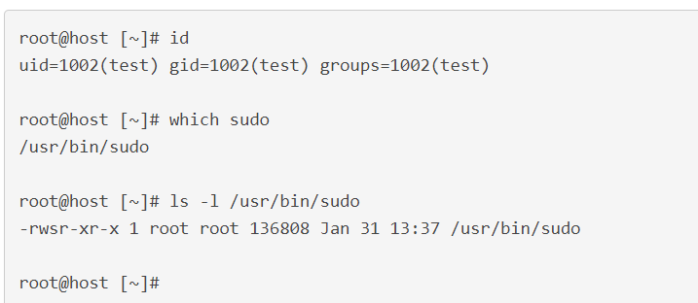
Setuid()
The most common example of this in Linux is ‘sudo’. In this example, the user ‘test’ located the executable ‘sudo’ and did a full listing of it with the ‘ls -l’ command.

Slide 67
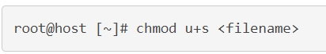
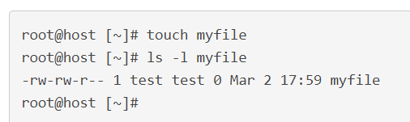
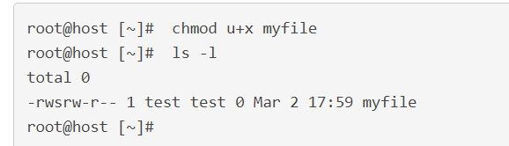
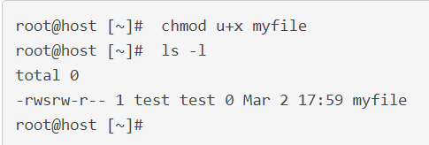
How Do I Set Up Setuid?
Notice that the file does not have the execute permissions for user, group, or world. We will add the setuid bit as seen below.
This output looks a little different from what we were expecting. The lowercase ‘s’ we were looking for is the now a capital ‘S.’ This signifies that the setuid IS set, but the user that owns the file does not have execute permissions.

Slide 68
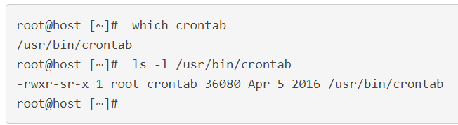
What is Setgid?
Setgid, when used on files, is very similar to setuid.
A process, when executed, will run as the group that owns the file.
A typical example of a file that uses this is the ‘crontab’ command.
Notes:
https://www.liquidweb.com/kb/how-do-i-set-up-setuid-setgid-and-sticky-bits-on-linux/

Slide 69
Security Problems of Programs with suid/sgid
These programs are typically setuid root
Violates the least privilege principle
every program and every user should operate using the least privilege necessary to complete the job
Why violating least privilege is bad?
How would an attacker exploit this problem?
How to solve this problem?

Slide 70
Unit 5 – System Security (I)
User Authentication
Unix Access Control

Slide 71
Computational Intelligence (TC2027)

